Slide 1
CS 513 Knowledge Discovery And Data Mining – Project Credit Card Lead Prediction
Final Project Presentation

Slide 2




Team Members
Anith Joy
CWID: 20016161
Section B
Anurag Athwale
CWID: 20012263
Section B
Shubhankar Deol
CWID: 20013072
Section B

Slide 3
Credit Card lead Prediction Problem Statement

Slide 4
Index
Background
Dataset Description
Feature Discussion
Dataset Challenges
Model Selection
Conclusion and Discussion

Slide 5
Background
Identifying potential credit card leads is critical for financial institutions to expand their customer base and increase revenue.
Acquiring new credit card customers is a key driver of business growth and profitability in the financial sector.
Credit cards can impact the economy in several ways, both at the individual and macroeconomic levels.
Business Revenue
Interest Income for Financial Institutions
Debt Levels and Financial Stability
Credit Scores and Access to Credit

Slide 6
Our Dataset
The dataset chosen for this project is the "Credit Card Lead Prediction" dataset from Kaggle.
The objective of this project is to identify customers who are likely to show higher intent towards acquiring a recommended credit card.
The "Is_Lead" column serves as the target outcome variable which denotes the customer's interest in obtaining a credit card (0: Not interested, 1: Interested).
The dataset comprises train data of 245,725 instances with 11 columns and test data of 105,312 instances with 10 columns.
https://www.kaggle.com/datasets/shelvigarg/credit-card-buyers/data

Slide 7
Process
Data Collection
Data Preprocessing
Exploratory Data Analysis
Model Selection, Training & Testing
Feature Extraction
Conclusion

Slide 8
Credit Card lead Prediction
Features
Gender
Age
Region_Code
Occupation
Channel_Code
Vintage
Credit_Product
Avg_Account_balance
Is_Active

Slide 9
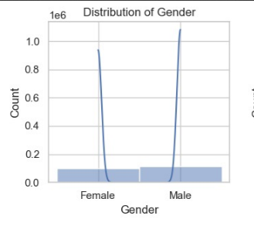
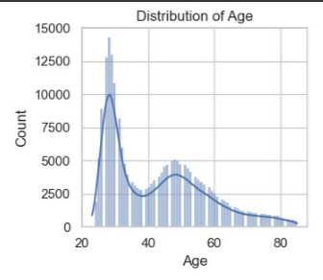
Features from our Database
Gender
Age

Slide 10
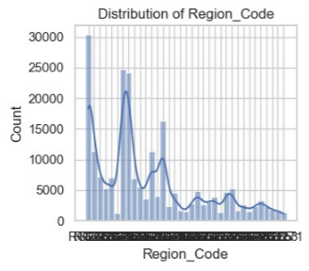
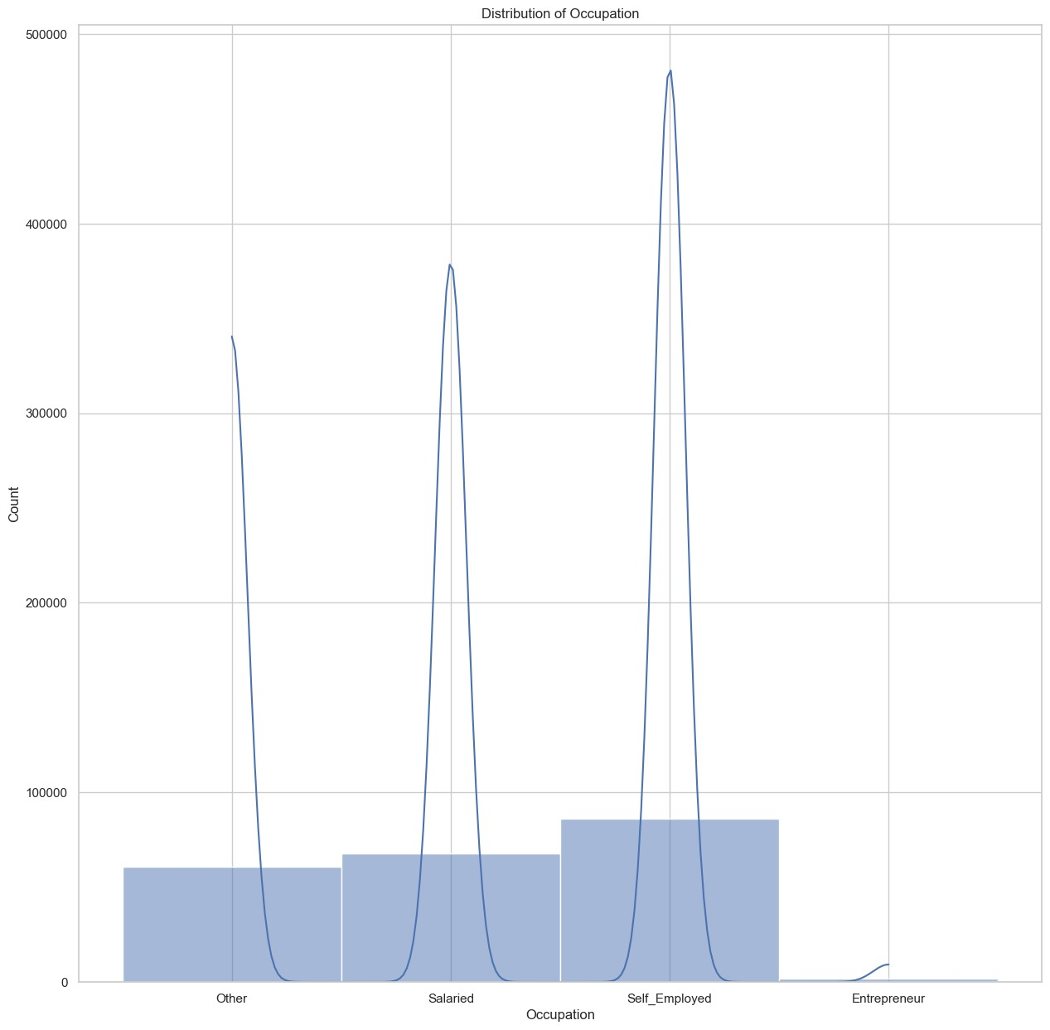
Region_Code
Occupation

Slide 11
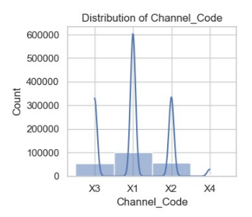
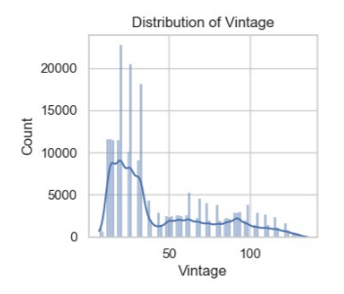
Channel_Code
Vintage

Slide 12
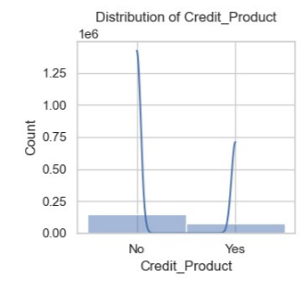
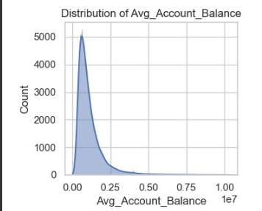
Credit_Product
Avg_Account_Balance

Slide 13
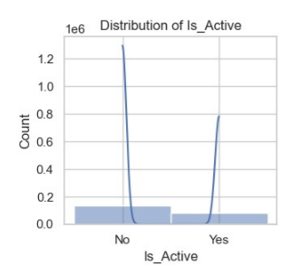
Account State

Slide 14
Dataset Challenges
Countering Imbalance
183087 Negative Labels
33313 Positive Labels
Identifying the need for undersampling vs oversampling
Identifying feature importance for classification
Dealing with missing values

Slide 15
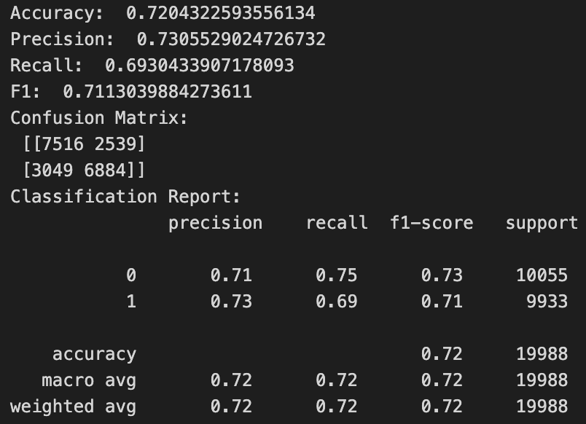
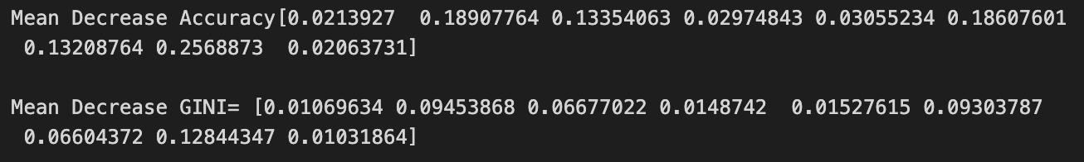
Random Forest

Slide 16
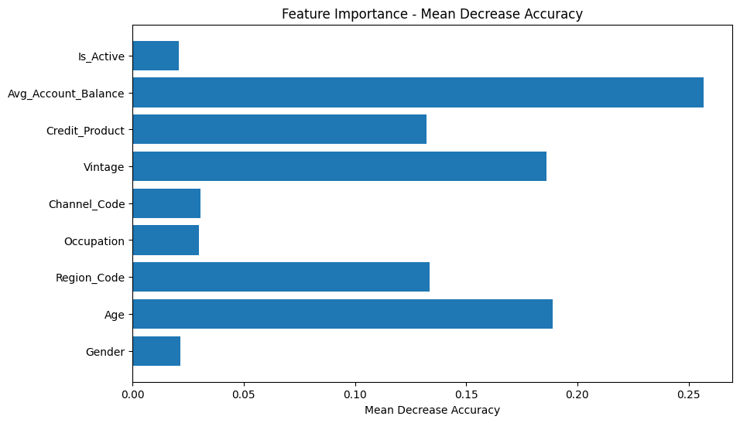

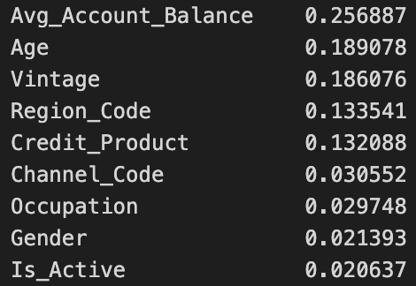

Slide 17
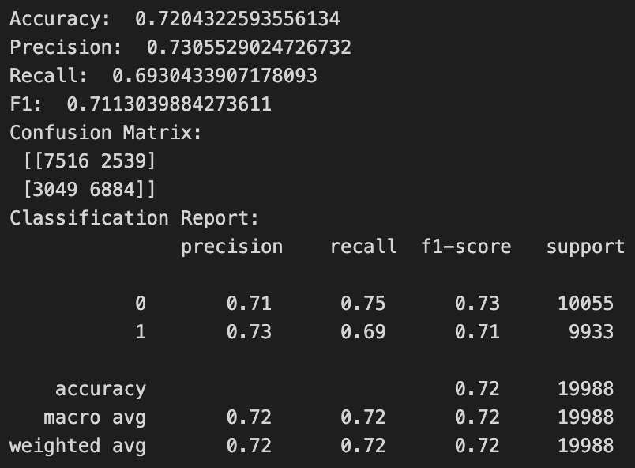
Random Forest with Reduced Features

Slide 18
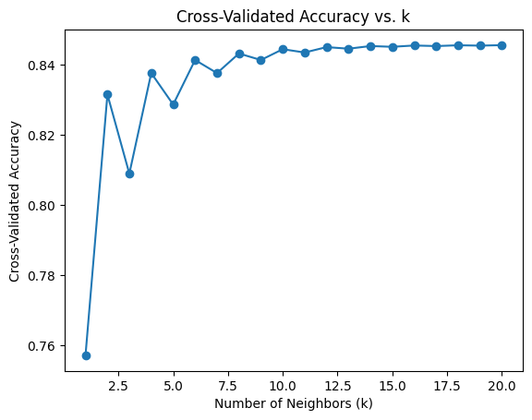
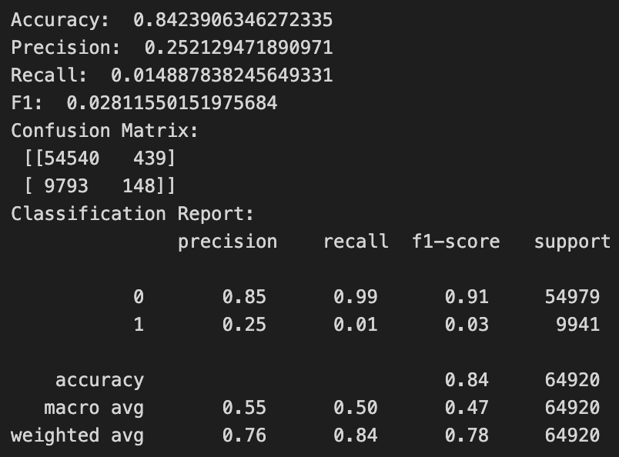
K-Nearest Neighbors

Slide 19
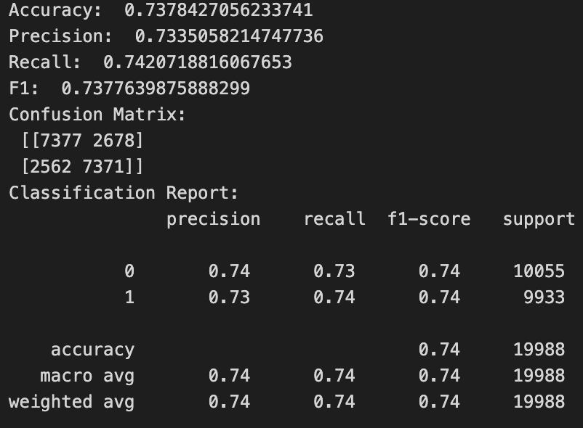
Decision Tree
Optimal Parameters:
Criterion: entropy
max_depth: 5
min_samples_leaf: 1
min_samples_split: 2

Slide 20
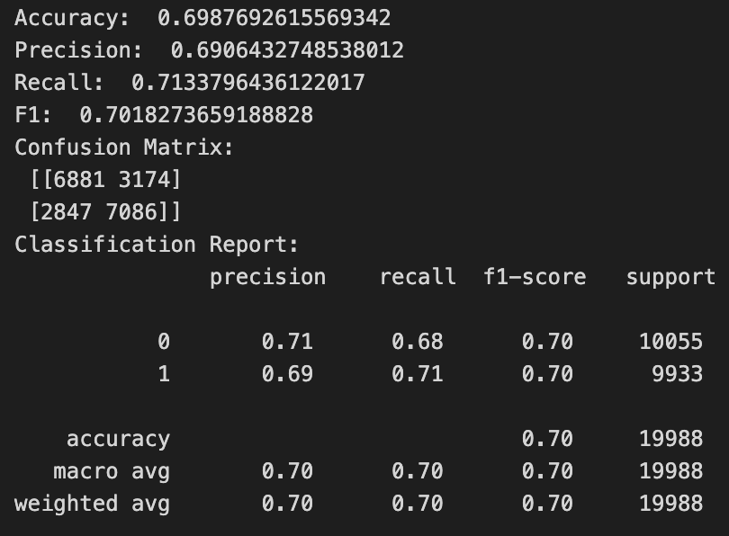
Logistic Regression
Optimal Parameters:
C: 1,
penalty: l1,
solver: liblinear

Slide 21
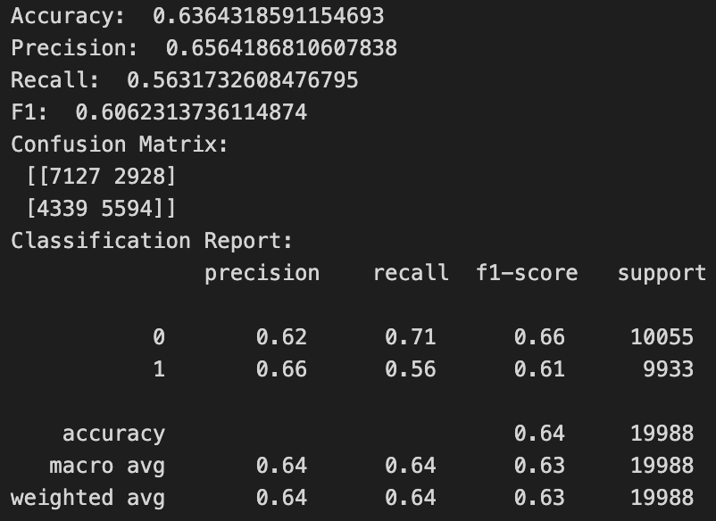
Naïve Bayes Optimal smoothing: var_smoothing: 1e-09

Slide 22
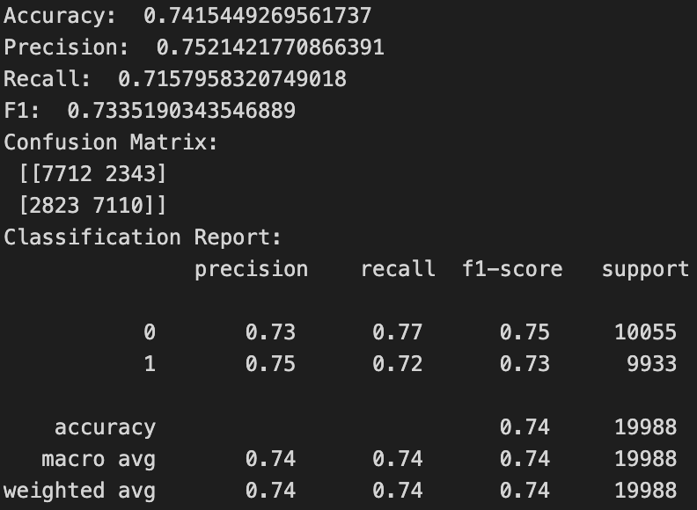
Gradient Boosting
Optimal Parameters:
colsample_bytree: 0.8
learning_rate: 0.2
max_depth: 5
n_estimators: 50
subsample: 0.8

Slide 23
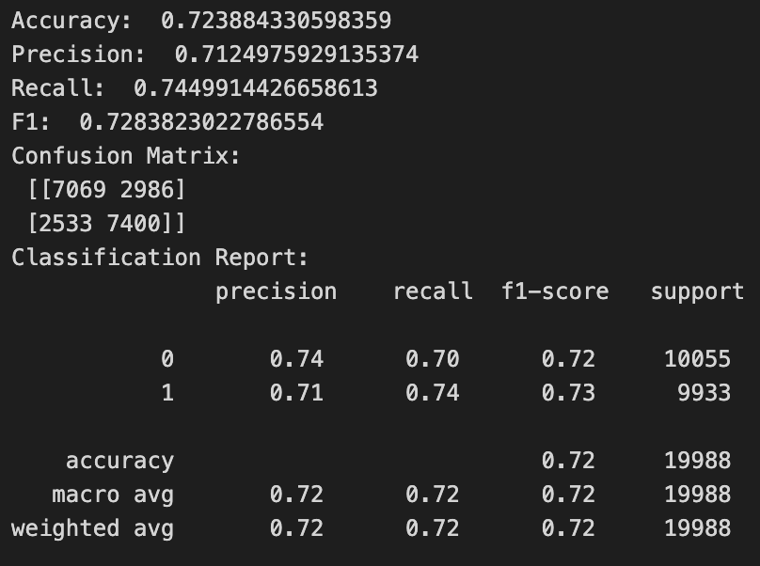
Adaptive Boosting Optimal Parameters: algorithm: SAMME.R learning_rate: 0.2 n_estimators: 200

Slide 24
Comparison

Slide 25
Conclusion and Discussion
Improved Targeting: Target marketing efforts towards individuals with a higher likelihood of responding positively to credit card offers.
Lead prediction is crucial for financial institutions to stay competitive in a saturated market.
Lack of Precision: Existing methods may result in a broad approach, targeting individuals that may not be genuinely interested.

Slide 26
Q&A

